Slide 1
Polly Pekapeka’s adventure to Waipiata, Central Otago
By Kenta (age 8)

Slide 2
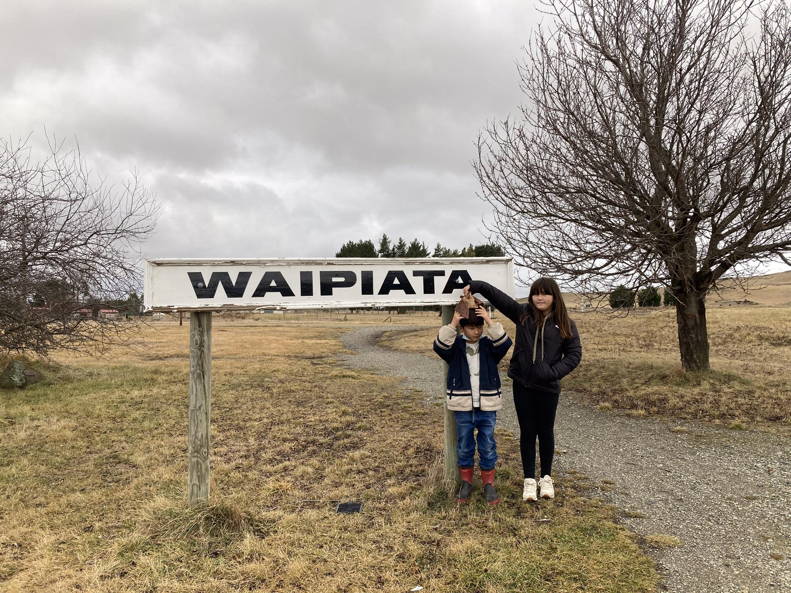
On my school holiday, my sister and I took Pollypekapeka to Ōtepoti / Dunedin to meet my grandparents. We decided to go to Waipiata together to search for snow.

Slide 3
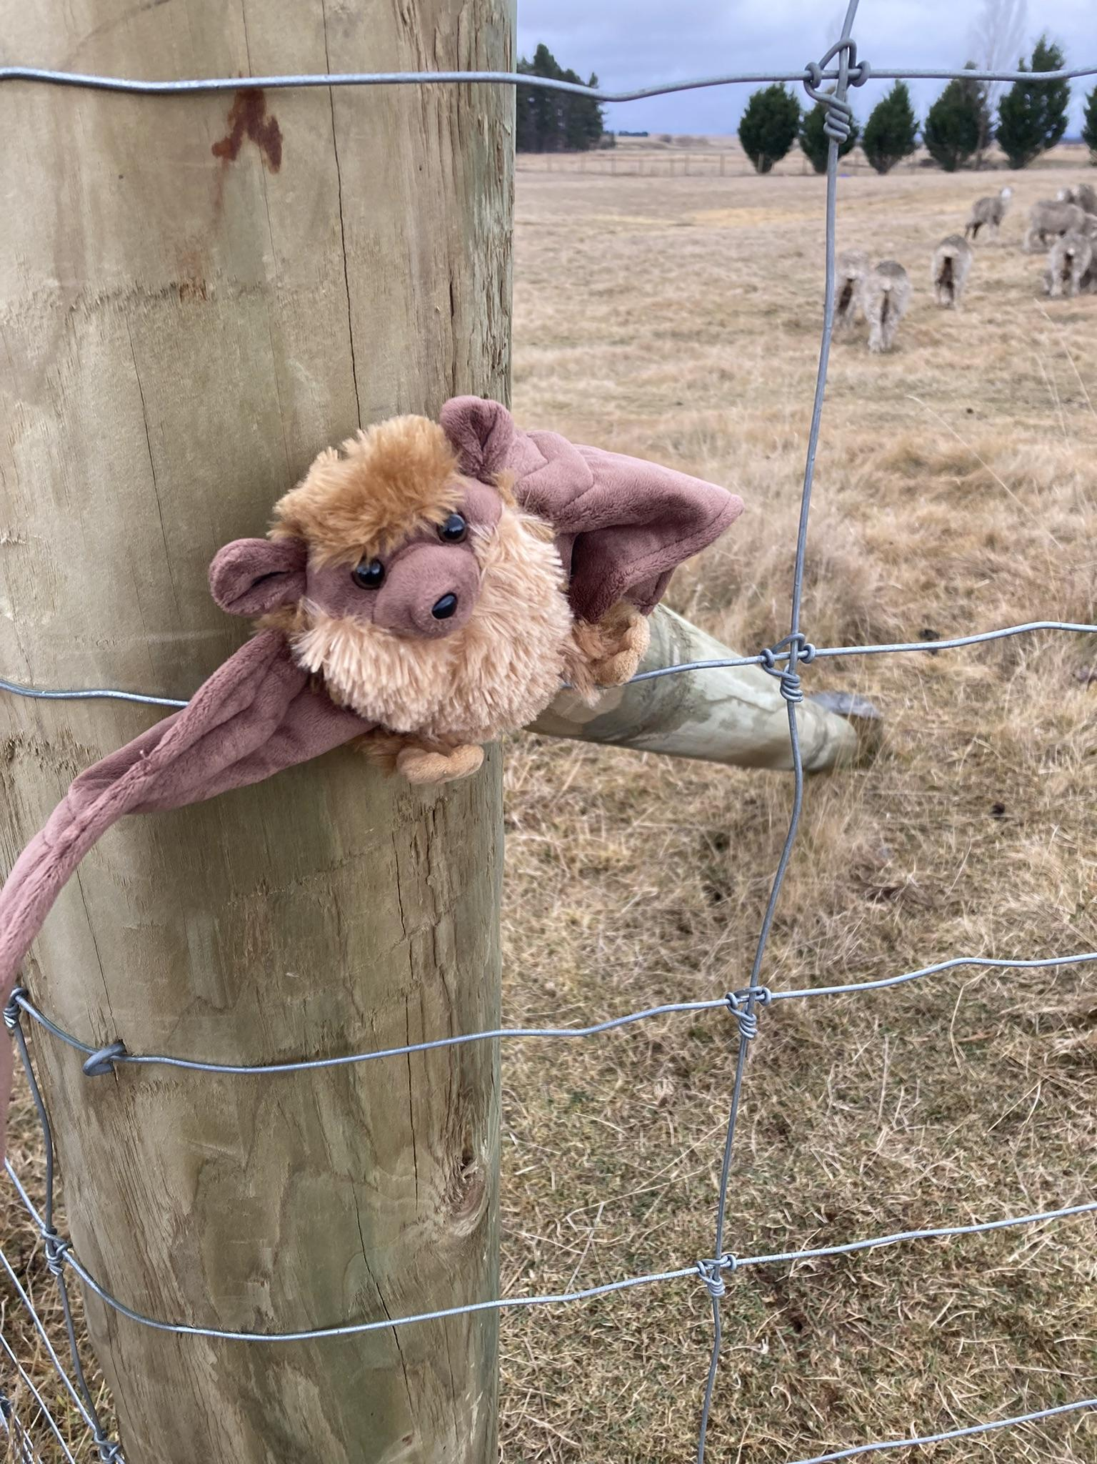
No snow here. Only dry grass.

Slide 4
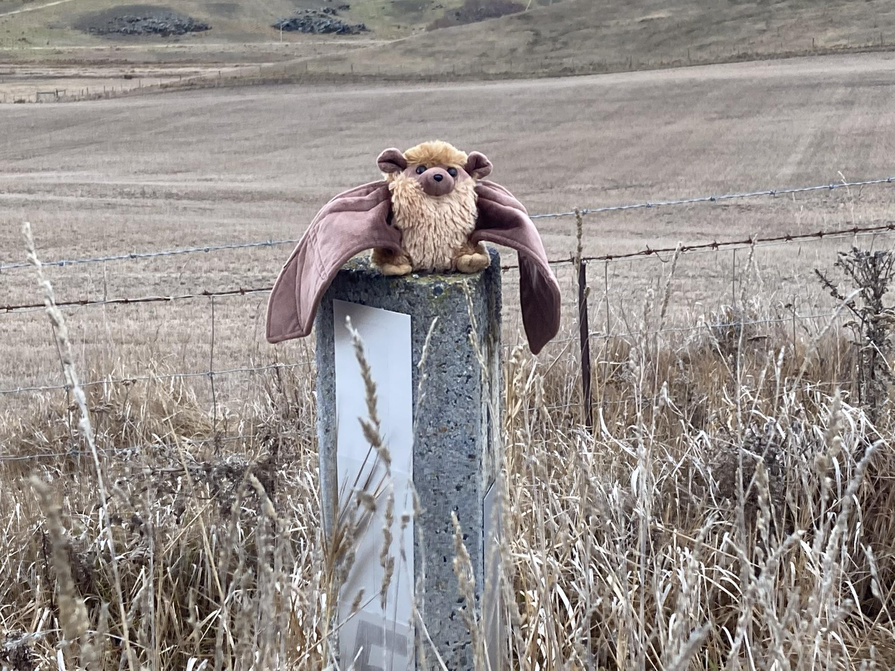
Heaps of dry grass!

Slide 5
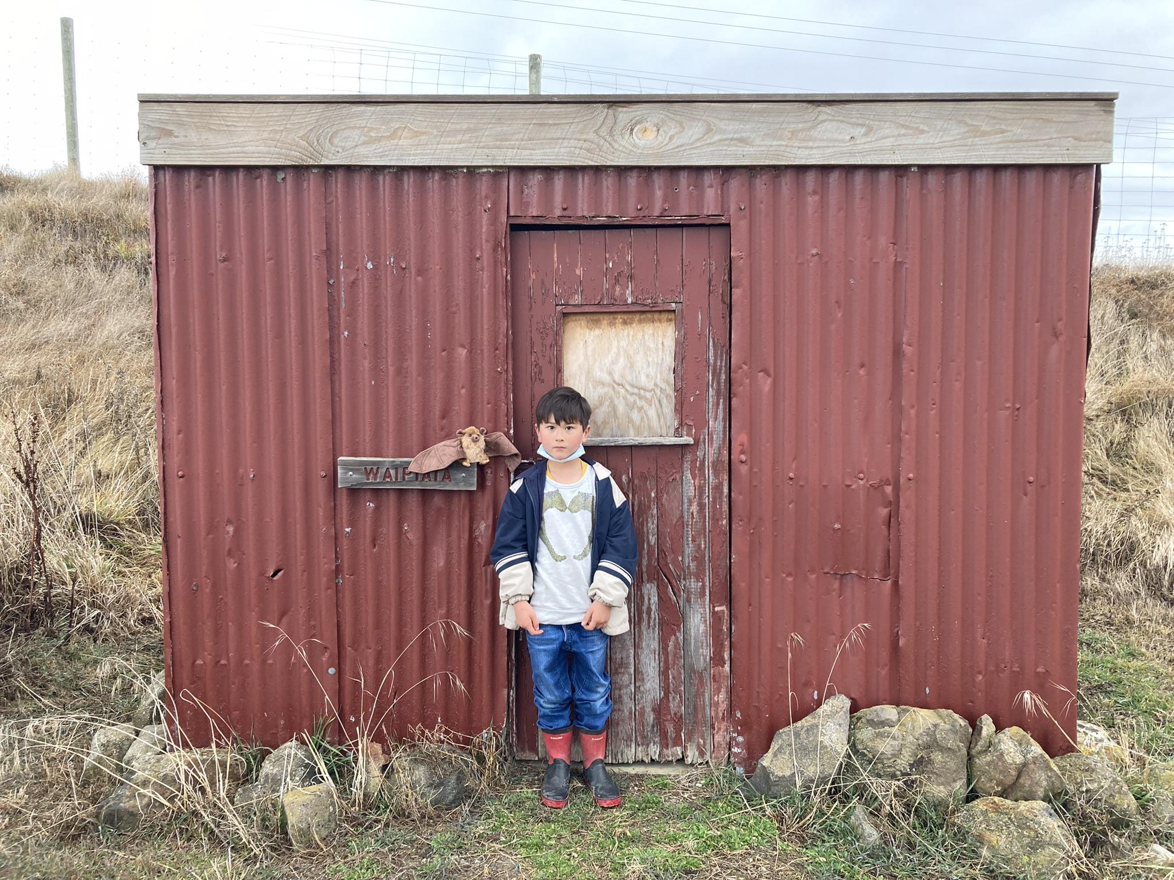
We walked some more and found an abandoned shed.

Slide 6
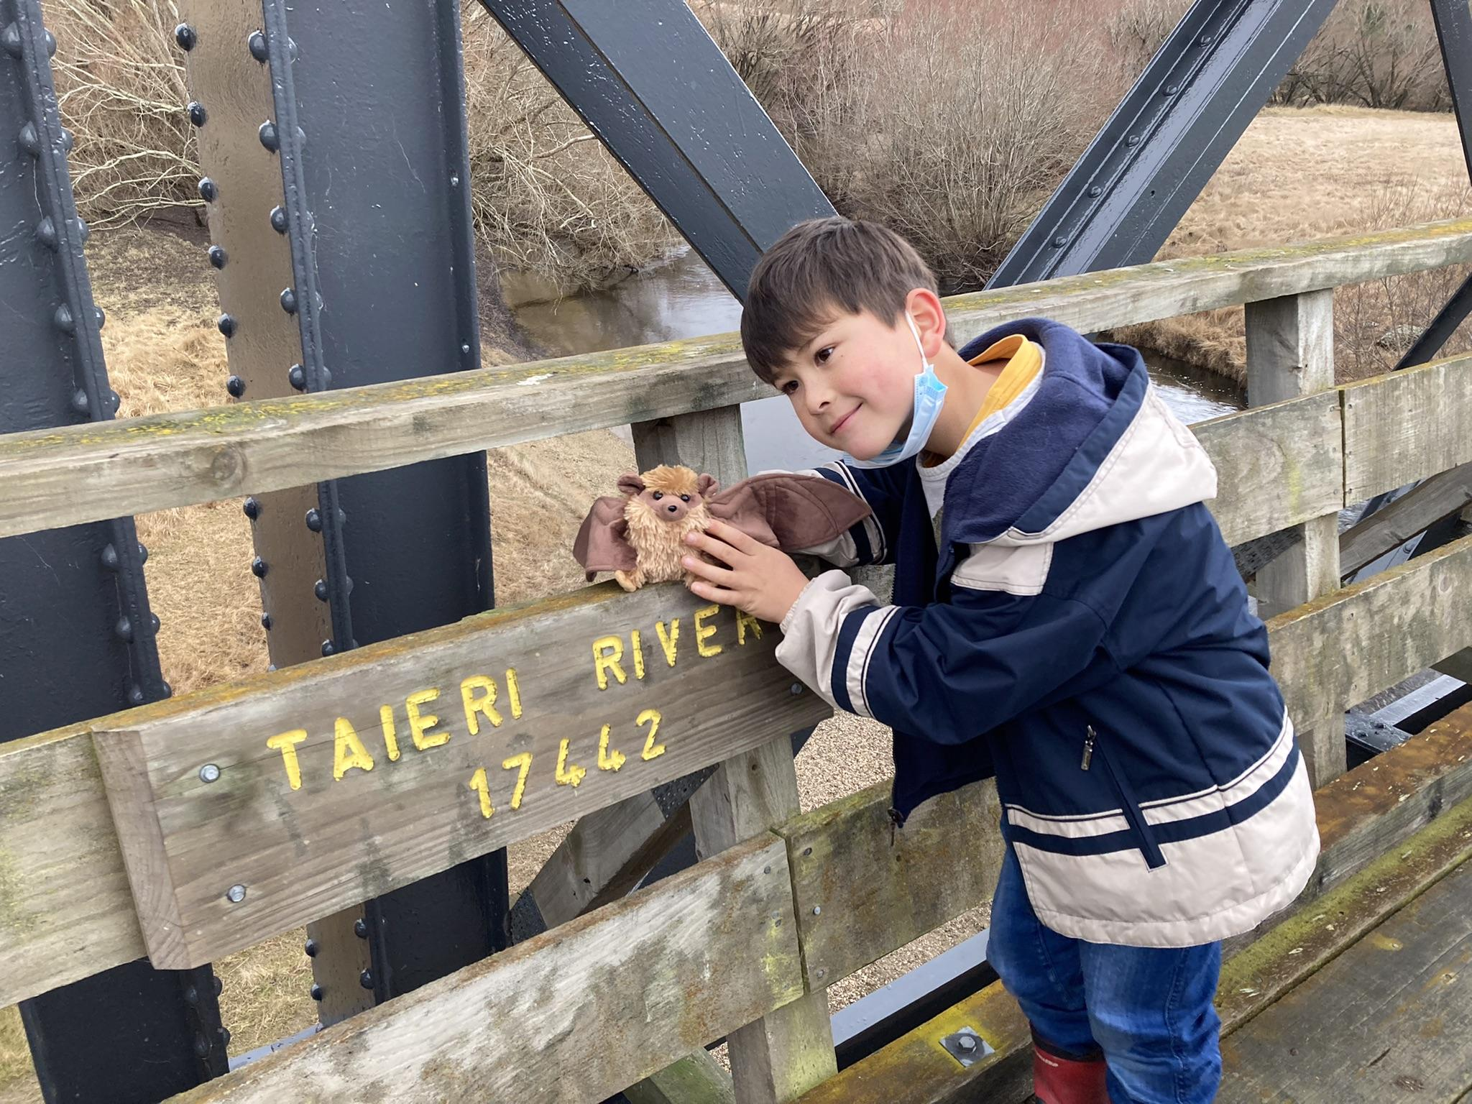
We walked over a river called Taieri river. The bridge was scary! Still no snow.

Slide 7
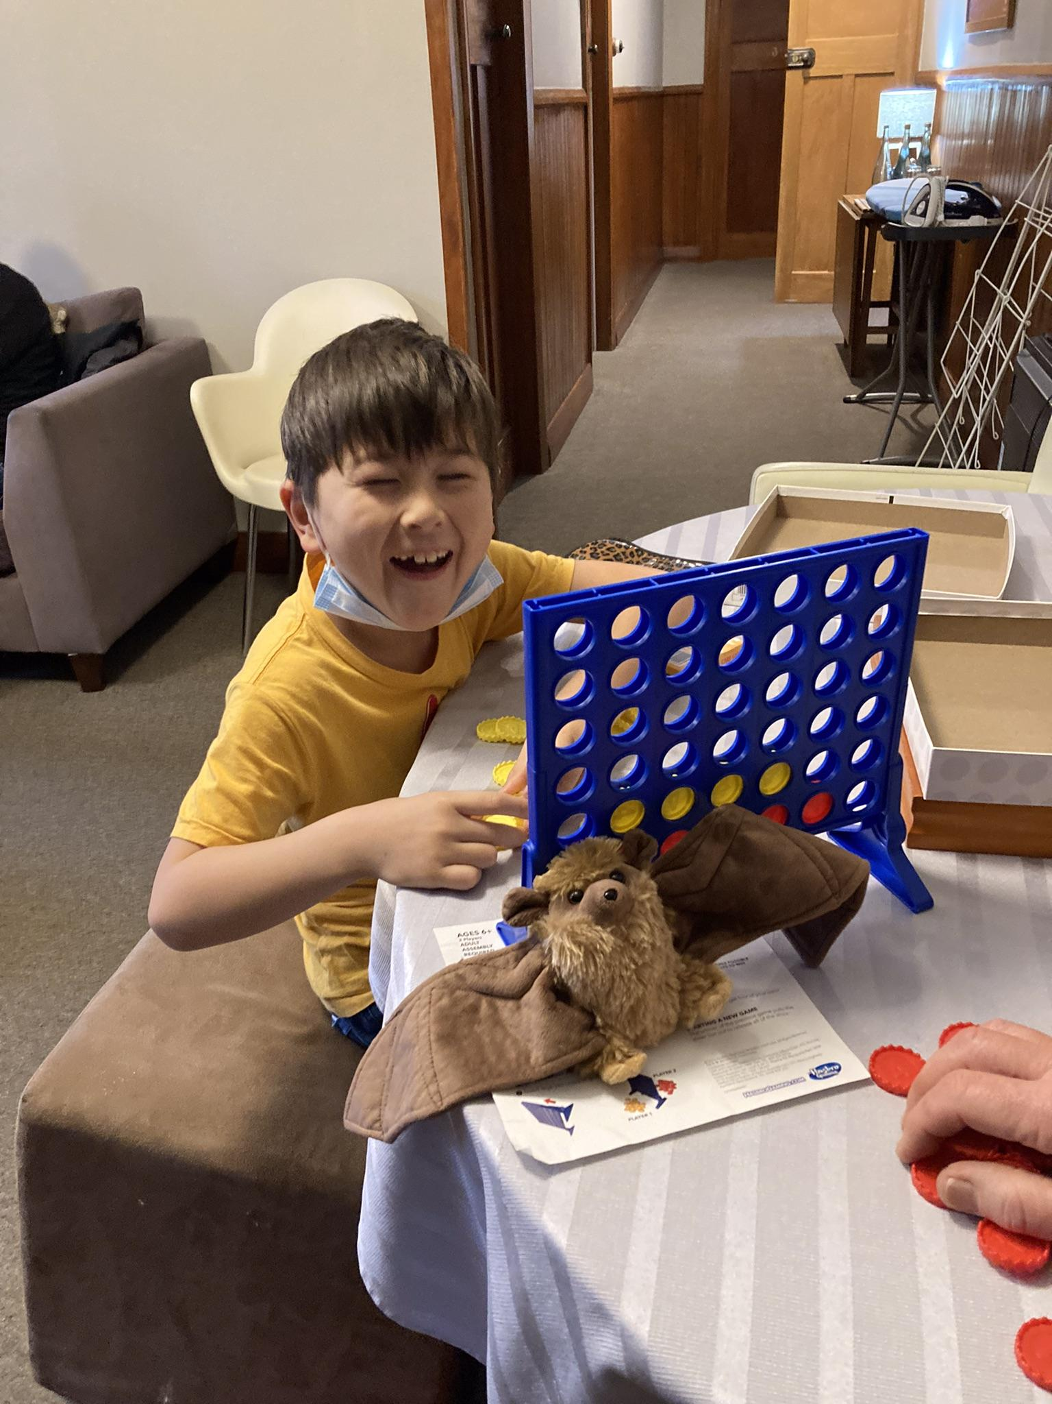
It was getting dark, so we decided to go back to the Waipiata Country Hotel.
I bet my grandparents in Connect 4 every time!

Slide 8
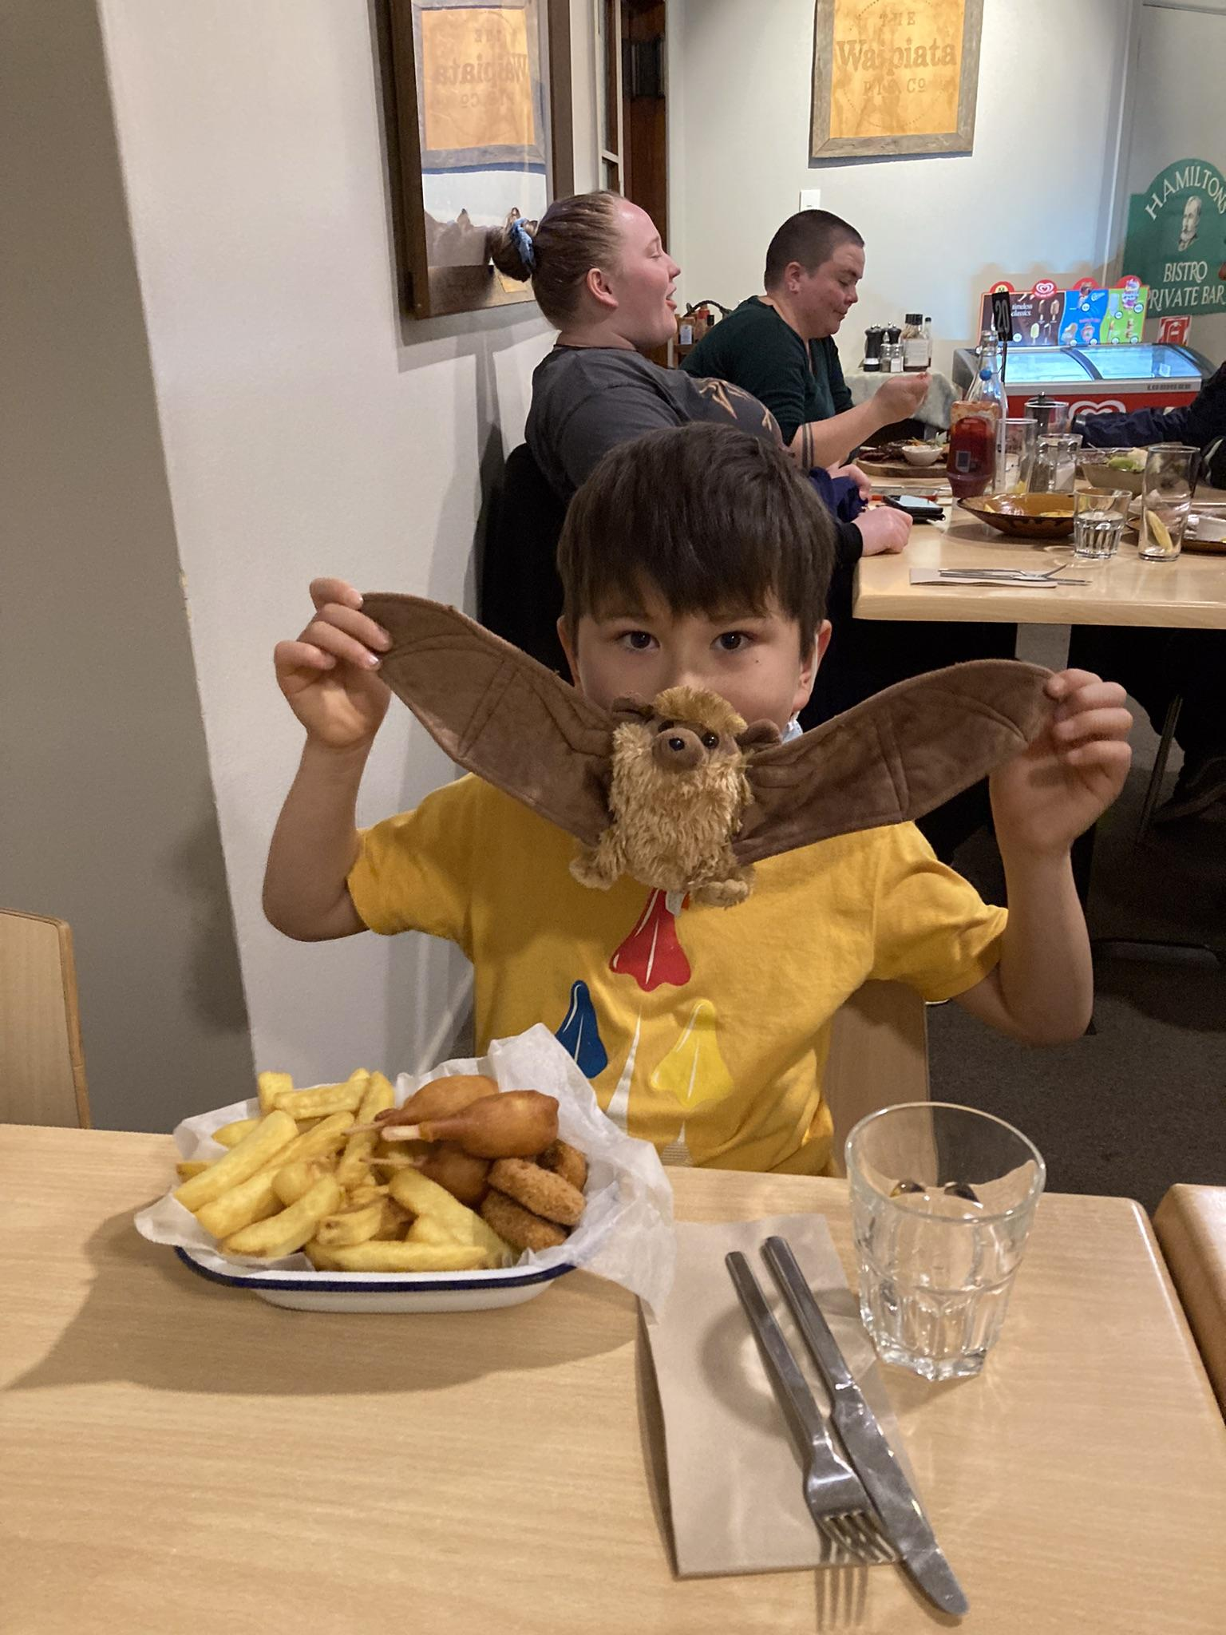
This was our dinner! Nom nom nom!

Slide 9
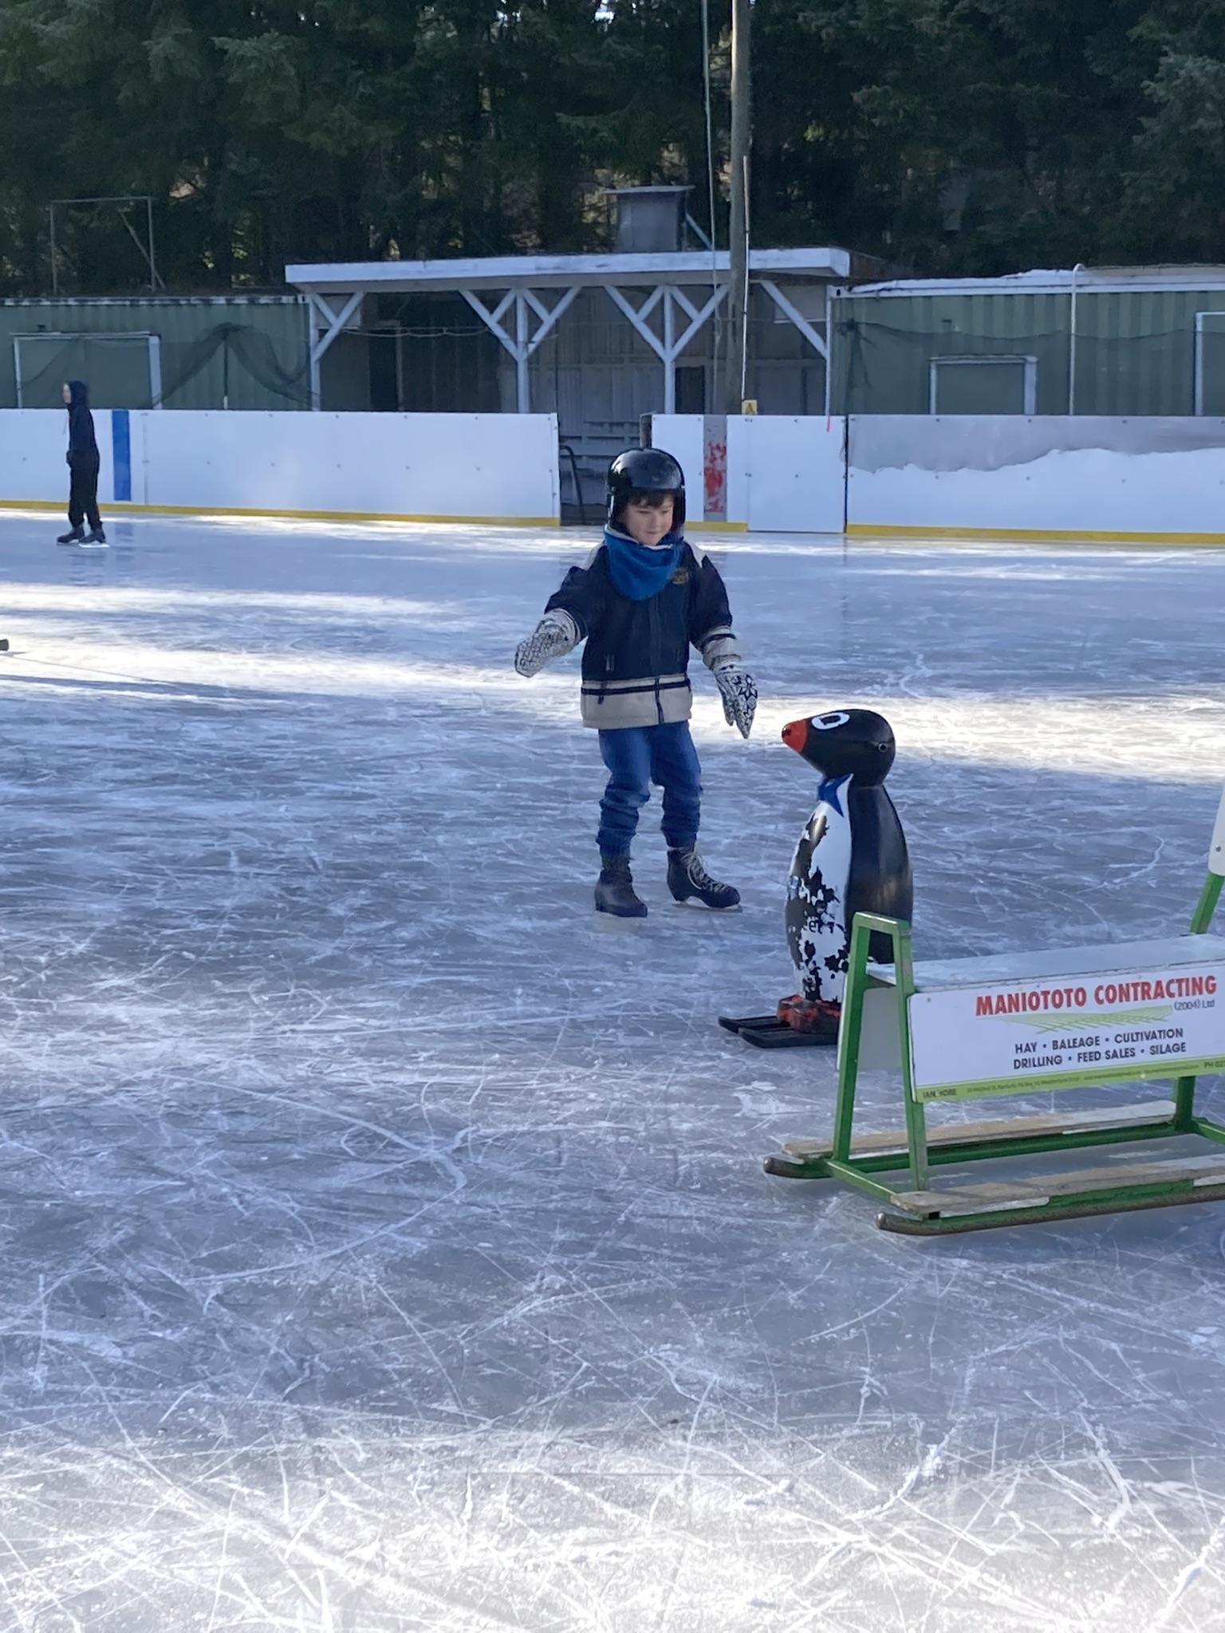
The next day, we went to Naseby in search of snow. We took a little break to go ice skating.

Slide 10
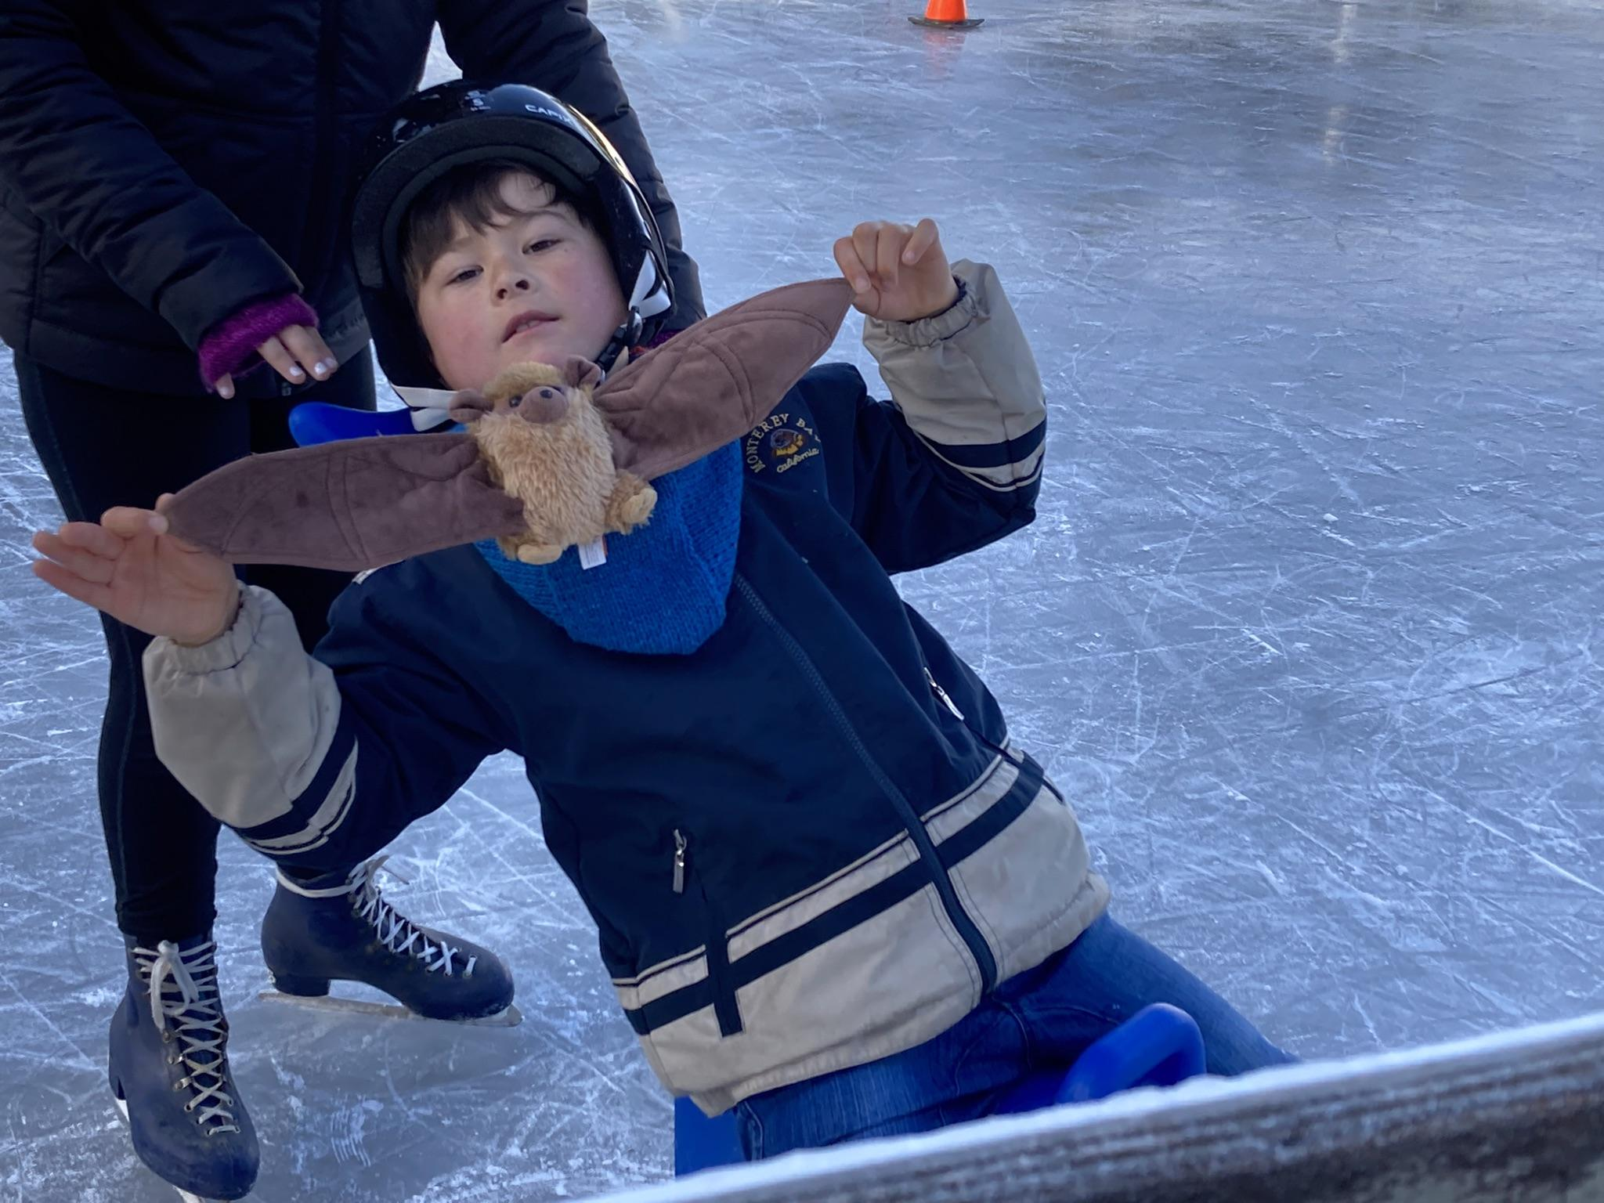
Woah!

Slide 11
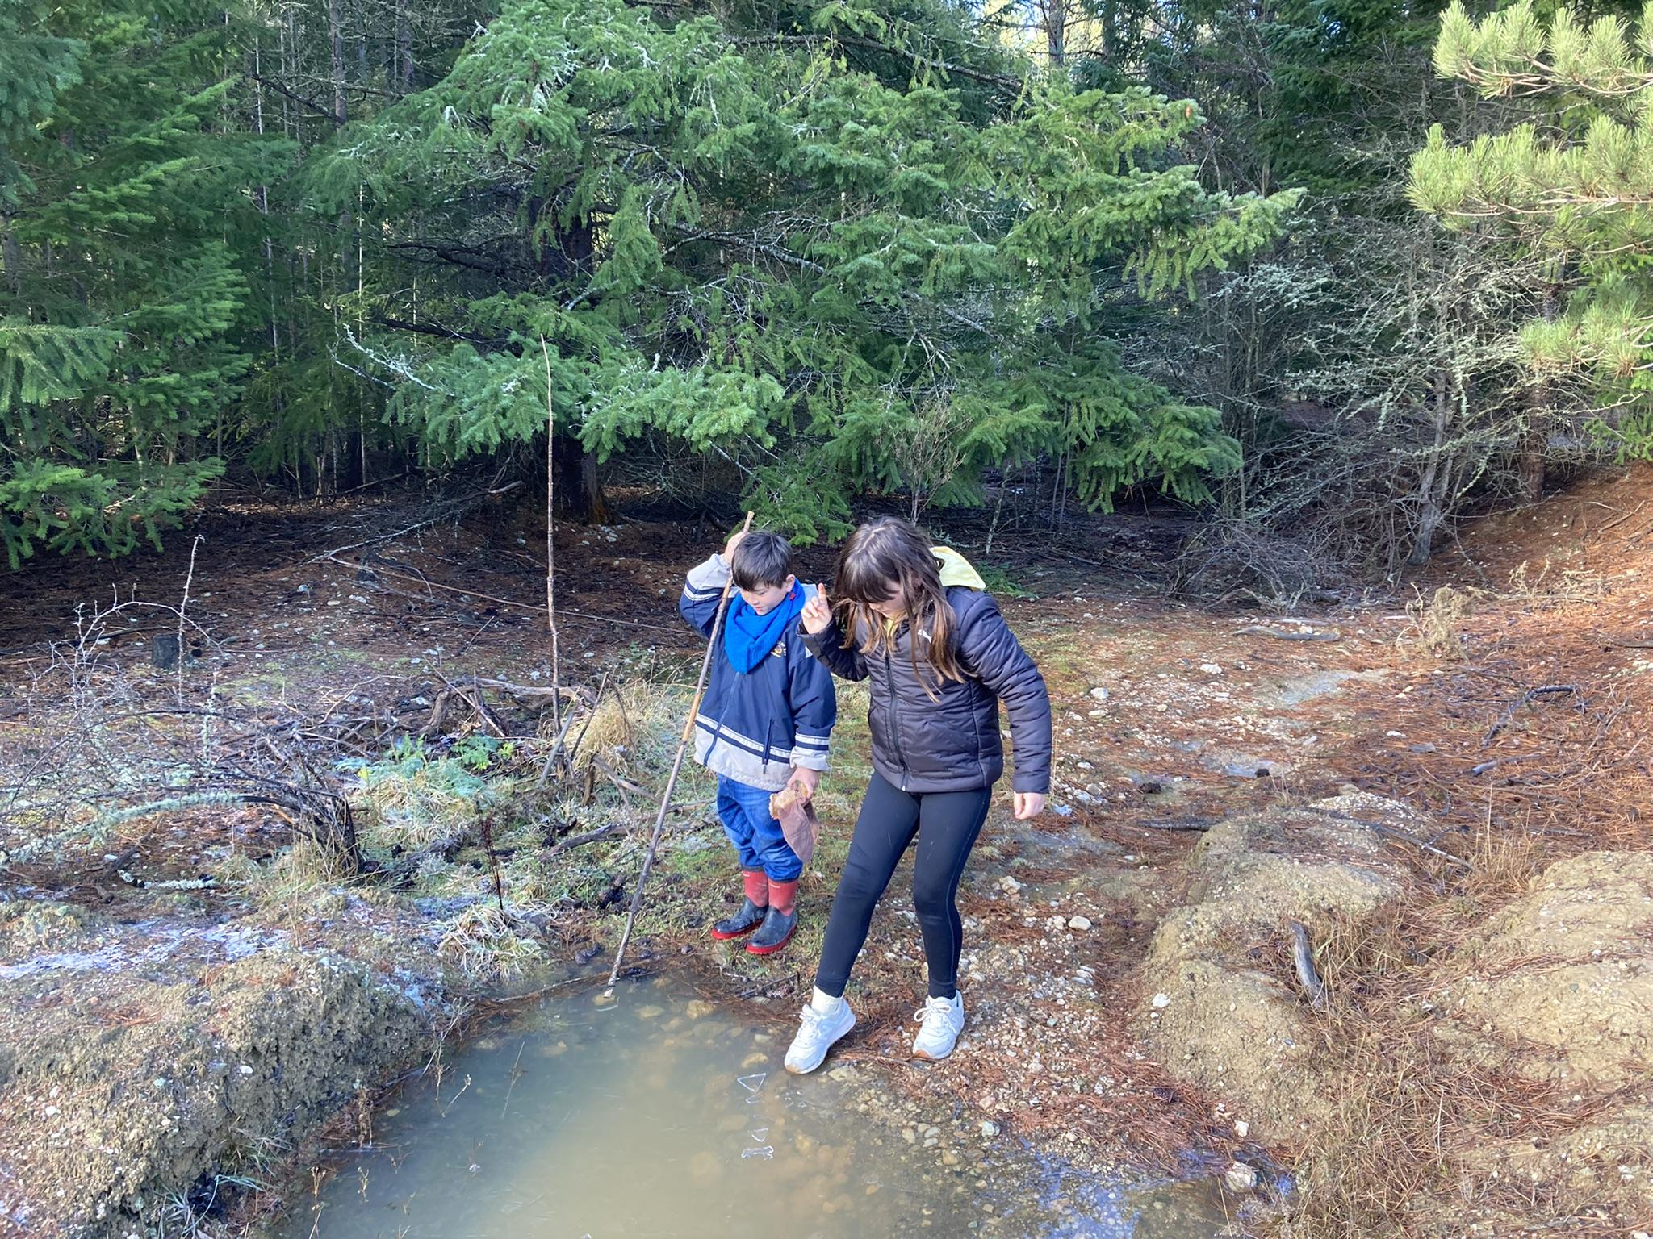
We found a frozen puddle.

Slide 12
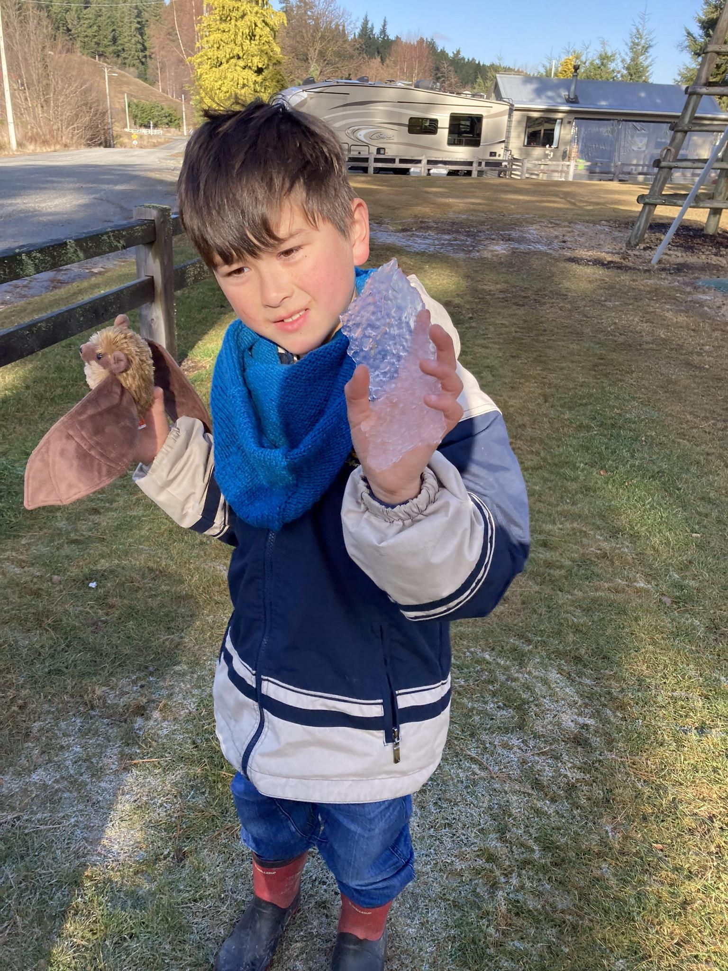
Look at the ice.

Slide 13
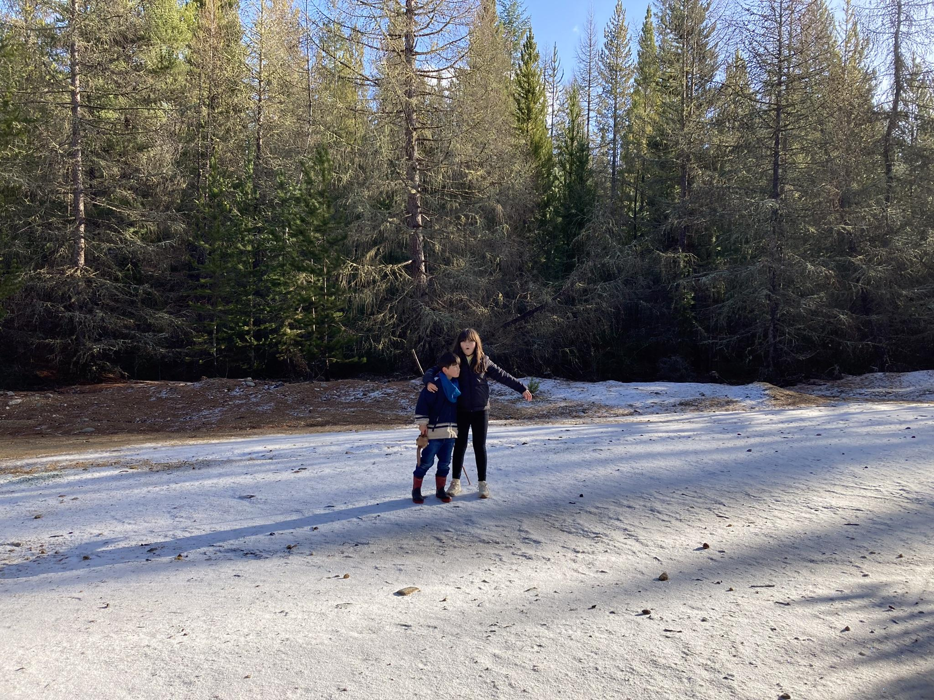
Snow! We finally found some :)

Slide 14
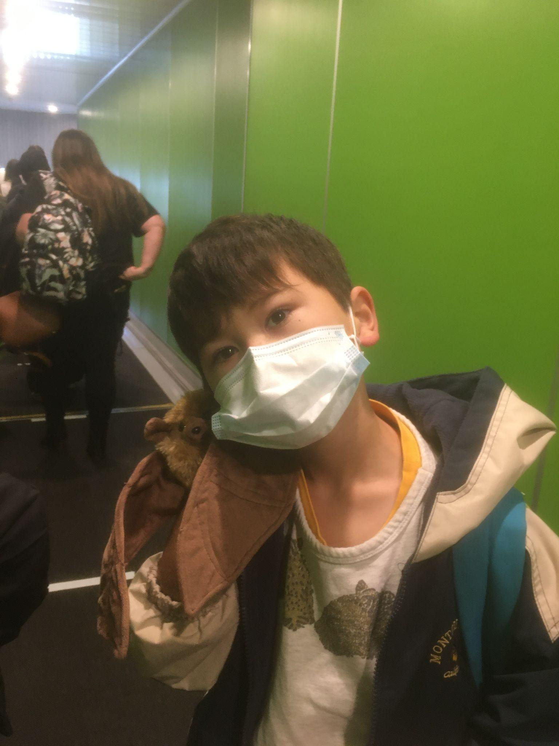
Flying home again back to Te Whanganui Atara / Wellington. Thanks for the adventure Pollypekapeka!

